Slide 1

ENTERPRISE DATA SCIENCE BOOTCAMP predicting the success of bank telemarketing campaigns
Group 28
Diogo Ferreira (20241143) | Francisco Moutinho (20240818) | Pedro Boto (20241144) | João Carvalho (20241340)

Slide 2

telemarketing campaign optimization: Who should we call? And when? This project identifies bank customers most likely to subscribe to long-term deposit products, helping improve campaign efficiency and conversion rates
AGENDA
Business Problem
Exploration and Data Analysis
Modelling Workflow
Feature Engineering
Modelling Approach
Results and Solution Output
Key Takeaways
This Photo by Unknown Author is licensed under CC BY-NC-ND

Slide 3





How can banks turn low-yield telemarketing campaigns into data-driven success stories?
Business Problem
Telemarketing is a key channel for banks to sell long-term deposits, but success rates are low
Objective
Develop a predictive model to determine whether a telemarketing call will result in a successful sale
GOALS
Improve campaign efficiency by targeting the right customers
Identify key factors influencing success
Provide actionable recommendations for strategy optimization
DATASET
Real-world data from a Portuguese retail bank (2008–2013), including customer demographics, product details, and socio-economic indicators
STAKEHOLDERS
Marketing and sales teams aiming to enhance campaign effectiveness

Slide 4




Our dataset captures the story of customer decisions—41K cases shaped by demographics, campaign history, and economic context.
SOURCE
Portuguese retail bank marketing campaigns (2008–2013)
SIZE
41,188 records, 20 features
TARGET
y → term deposit subscription: YES/NO
CLASS IMBALANCE
Only ~11% positive responses
FEATURES & DATA TYPES
Customer Demographics
Integer - age
Categorical- job, marital, education, default, housing, loan
Campaign Details:
Categorical - contact, month, day_of_week
Integer – duration
History:
Integer - campaign, pdays, previous
Categorical – poutcome
Economic Indicators:
Float - emp_var_rate, cons_price_idx, cons_conf_idx, euribor3m, nr_employed
Note: duration excluded from modeling (data leakage)

Slide 5








MODELLING WORKFLOW: FROM DATA EXPLORATION TO MODEL DEPLOYMENT
EDA — Exploratory Data Analysis
Baseline Modelling
XGBoost Modelling
Deployment to Hugging Face
Understand customer behaviour, macroeconomic influences, and campaign outcomes through visualizations and statistical analysis. These insights guide feature engineering and model selection
XGBoost handles nonlinearities, interactions, and mixed data types effectively. Hyperparameters and SMOTE balancing are optimized to maximize F1 score.
The selected model is wrapped inside a Gradio application and deployed to a Hugging Face Space, providing an intuitive interface for real-time predictions
A simple logistic regression is fitted with minimal preprocessing to provide a starting point for performance comparison
1
2
3
4
5
6
7
Data Cleaning & Preprocessing
Logistic Regression Modelling
Best Model Selection
Code and support files deployed using GIT (GIT Hub)
The dataset is standardized by normalizing column names, removing duplicates. This step ensures data quality and prevents leakage in later modelling
We introduce engineered features, WOE encoding, PCA, and SMOTE to improve the logistic model’s ability to separate classes. This model establishes a more realistic approach for the given problem
All models are compared using their F1 scores after threshold tuning, and the best model is selected
20241143/EDSB_25_28

Slide 6



Key data patterns guided targeted feature engineering—transformations, encoding, and new features to improve predictive power
EDA KEY FINDINGS
ECONOMIC INDICATORS
Strong correlation among macroeconomic variables
Different scales require normalization
NUMERICAL FEATURES
High skewness and outliers in age, campaign, previous
pdays behaves as binary (mostly 999)
FEATURE IMPORTANCE
duration leaks target → removed
month shows seasonality
poutcome strongly predicts success
HIGH CLASS-IMBALANCE PROBLEM
'No' is the dominant class (almost 90%) → F1 score and use of Resampling Techniques (SMOTE)
PREPROCESSING & FEATURE ENGINEERING
ECONOMIC INDICATORS
Applied PCA → 2 components were kept to reduce multicollinearity
NUMERIC TRANSFORMATIONS
pdays → binary feature
month & day_of_week → cyclical encoding
CATEGORICAL HANDLING
Reduced cardinality (job: 11→7, education: 7→5)
Imputed missing values → mean; median; mode
Enconding → WOE encoder
NEW FEATURES
age × marital → interaction effect
job × age → proxy for career stage
campaign_log → log transformation of campaign
contacts_ratio → ratio of contacts to previous
economic_volatility → combined macroeconomic variability

Slide 7
Modelling Approach: From a baseline model to a pipeline process
MODELLING STRATEGY
1. A simple Baseline model was implemented to provide a reference point for comparison
2. Two Models were tested, and their metrics were assessed to evaluate their performance
A Pipeline was built for each model:
Cleaning and imputation
Preprocessing and Data Transformation
Resampling (due to high class imbalance)
Model fitting
Model details
 | BASELINE | MODEL 1 | MODEL 2
Type | Logistic Regression | Logistic Regression | XGBoost
Feature Transformation | One-hot enconding | Pre-processsing & Feature Engineering | Pre-processsing & Feature Engineering
Reampling Techniques | None | SMOTEEN | SMOTE
Metric Criteria | F1 | F1* | F1*
Hyperparameters Gridsearch: CV: 3 Scoring: ROC_AUC | Max_iter= 5000 Solver =lbfgs Penalty = L2 C= 1 (default) | Preprocessor_cat_woe_regul = [0.01, 0.1, 1, 10] Preprocessor_cat_select_k = [3, 6] Preprocessor_num_select_k =[5 , 10, 15] Smoteen_smote_k_neighbors: [3 , 5] Smoteen_sampling_strategy = [0.5 , 0,7] Max_iter= [500, 1000, 2000] Solver =lbfgs Penalty = L2 C= [0,01, 0,1, 1] | Preprocessor_cat_woe_regul = [0.1, 10] Preprocessor_cat_select_k = [4 , 7] Preprocessor_num_select_k =[5 , 10] Smote_k_neighbors: [3 , 5] Smote_sampling_strategy = [0.5 , 0,7] Model_max_depth = [3 , 5] Model_learnig_rate =[0.03 , 0.05 , 0.1] Model_n_estimators = [ 200 , 400] Model_subsample = [0.8 , 1] Model_colsample_bytree = [0.7 , 1] Model_min_child_weight = [1 .5]

Slide 8
Results —XGBoost achieved the best overall performance, handling imbalance and capturing complex patterns in the data...
Features used by model
Evaluation metrics
Feature | Baseline | LR Tuned | XGBoost
age | ✔ | ✔ | ✖
job | ✔ | ✔ | ✔
marital | ✔ | ✖ | ✖
education | ✔ | ✖ | ✖
default | ✔ | ✖ | ✖
housing | ✔ | ✖ | ✖
loan | ✔ | ✖ | ✖
contact | ✔ | ✔ | ✔
month | ✔ | ✖ | ✖
day_of_week | ✔ | ✖ | ✖
campaign | ✔ | ✔ | ✖
pdays | ✔ | ✔ | ✔
previous | ✔ | ✔ | ✔
poutcome | ✔ | ✔ | ✔
emp_var_rate | ✔ | ✖ | ✖
cons_price_idx | ✔ | ✖ | ✖
cons_conf_idx | ✔ | ✔ | ✖
euribor3m | ✔ | ✖ | ✖
nr_employed | ✔ | ✖ | ✖
Engineered Features | ✖ | ✔ | ✔
 | Baseline | LR Tuned | XGBoost
ROC AUC | 0.78 | 0.79 | 0.80
Accuracy | 0.90 | 0.87 | 0.87
Precision | 0.67 | 0.45 | 0.45
Recall | 0.22 | 0.52 | 0.57
F1 | 0.33 | 0.49 | 0.51
The XGBoost model was selected as the final production model because it achieved the highest F1-score, offering the best balance between Recall and Precision among all evaluated models
For the Telemarketing Long-Term Deposit problem, the objective is two-fold:
1. Maximize Recall: Ensure that as many interested clients as possible are correctly identified, reducing missed opportunities
2. Maximize Specificity: Reduce the number of unnecessary calls to uninterested clients, improving operational efficiency and lowering campaign costs
BEST MODEL

Slide 9
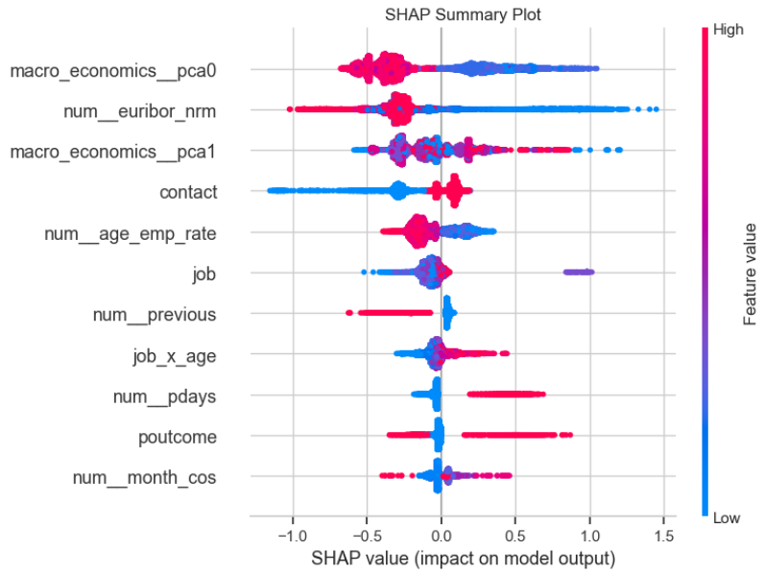
Key predictive features in the final xgboost model
Features used by XGBOOST and their SHAP summary
The model is mostly dominated by macroeconomic indicators:
Recession periods leads to lower success rates
Strong and stable economic periods (lower euribor rate) tend to be beneficial for customers
Type of contact has influence on the campaign success rate:
Positive outcome when contact is made by Cellular
Slightly negative outcome when contact is made by Telephone
Age interaction with employment variation rate showcased relevant patterns for targeting groups:
Older individuals even during positive employment variation are averse to commit to long term deposits
Younger individuals are keen to sign long term deposits during stable economic periods

Slide 10
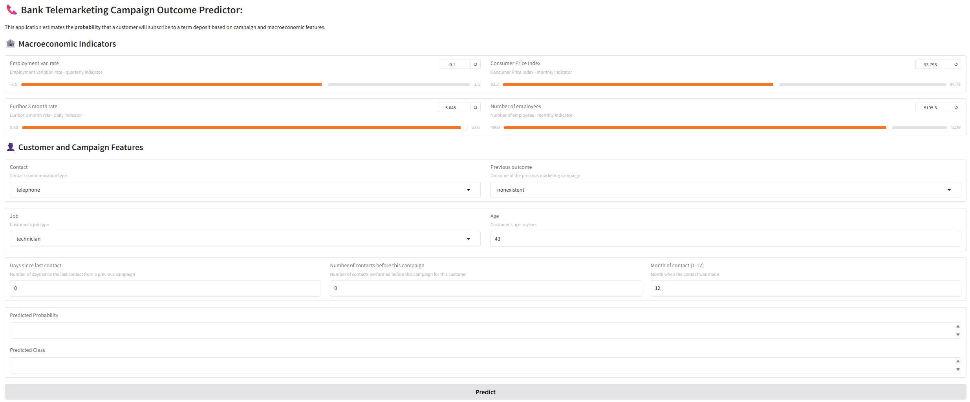
User-Friendly Predictive App Deployed for Sales Teams
Ready for operation interface was deployed
Interactive and Practical tool suitable for all types of technological users
Sales Teams can use this app to evaluate if a certain Customer should be called or not
PLEASE HAVE A GO! 🤗 Bank Telemarketing Predictor

Slide 11
Key-take aways and future works
KEY - TAKE AWAYS :
Banks can use this predictive model to choose the periods of telemarketing campaigns;
Avoiding calling during periods of recessions → Reducing costs on Human Resources and Unwanted Calls
Advantageous to perform and adjust interest rates strategies beforehand anticipating the number of customers that are willing to accept this campaign
Identifying target groups, mostly by age discrimination, and adapting the long-term deposit rules to their preferences
FUTURE WORKS:
Model 2.0:
Group Target identification: Re-evaluation of input dataset including new attributes such as individual economical attributes
Testing other resampling techniques due to high level of imbalance data and/or having access to more data
Output Integration:
Integrate Bank Customers DB and Macro Economic Indexes for automatic scheduling telemarketing campaign
Need to provide how long should telemarketing campaign run
Minimum number of Long- Term Deposits

Slide 12

The end

Slide 13
aPPENDix

Slide 14
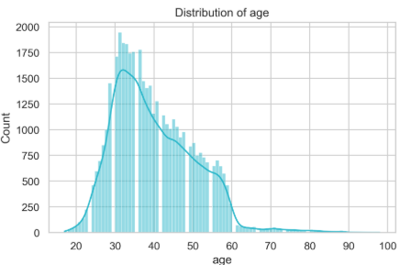
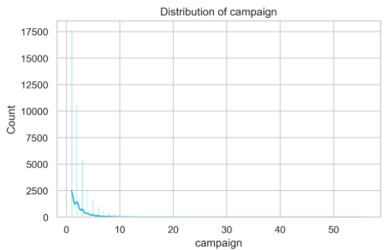
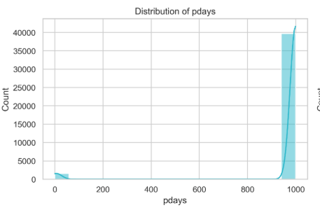
Numerical distribution (AGE, CAMPAIGN, PDAYS)
Age
Campaign
pdays
Right-skewed, concentrated roughly between 30–50 years
Highly right-skewed; most customers are contacted only a few times, with a long tail of repeated attempts
Dominated by the value 999 (no previous contact), effectively making it close to a binary indicator

Slide 15
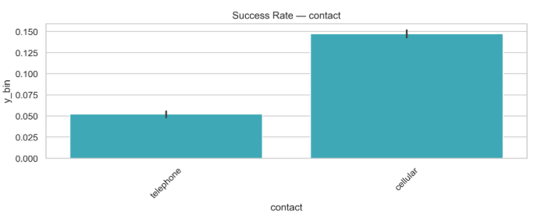
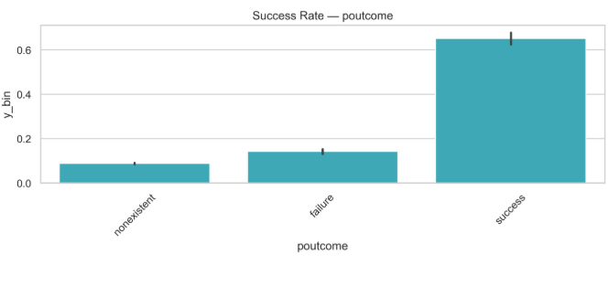
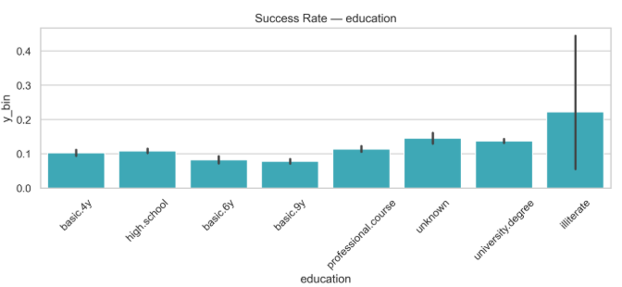
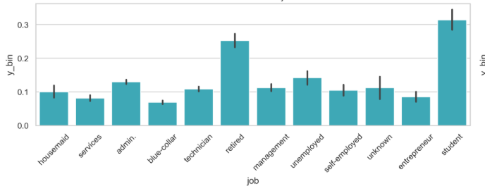
Succes rate by categorical VARIABLE #1 (contact, poutcome, job, Education)
Cellular and Successful outcomes in previous campaign tend to contribute to a successful subscription
Student and Retire people tend to adhere more Long-Term subscriptions

Slide 16
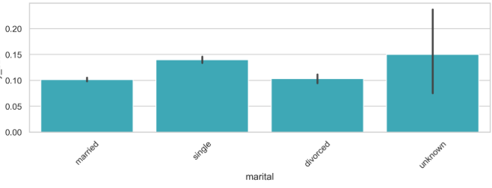
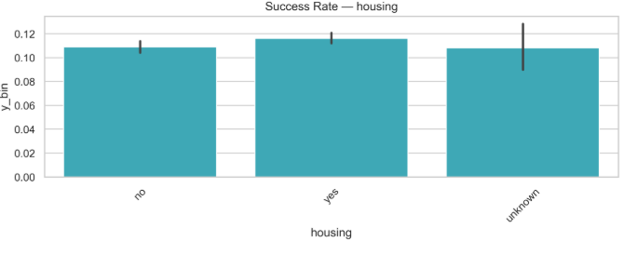
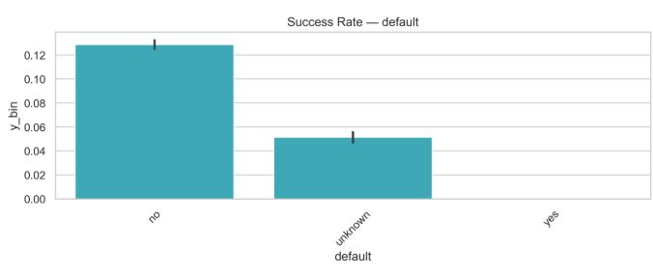
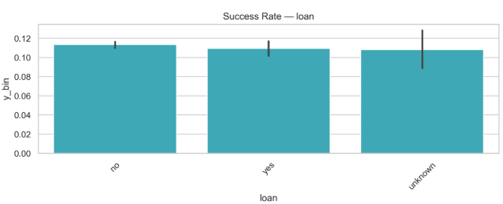
Succes rate by categorical VARIABLE #2 (Housing, loan, Marital, default)
Distribution of Housing, Loan, marital does not show high influence on target behaviour
Default has no influence on target variable

Slide 17
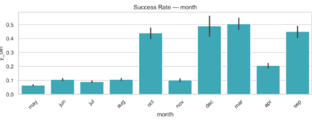
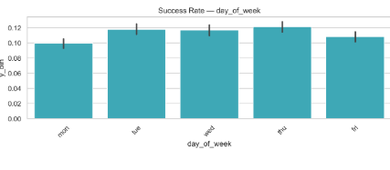
Succes rate by categorical VARIABLE #3 (month, day of week)
Uneven Distribution of success rate by Month( more prevalent) and day of the Week
Potentially need to assure a numerical encoding without losing cyclical characteristic

Slide 18
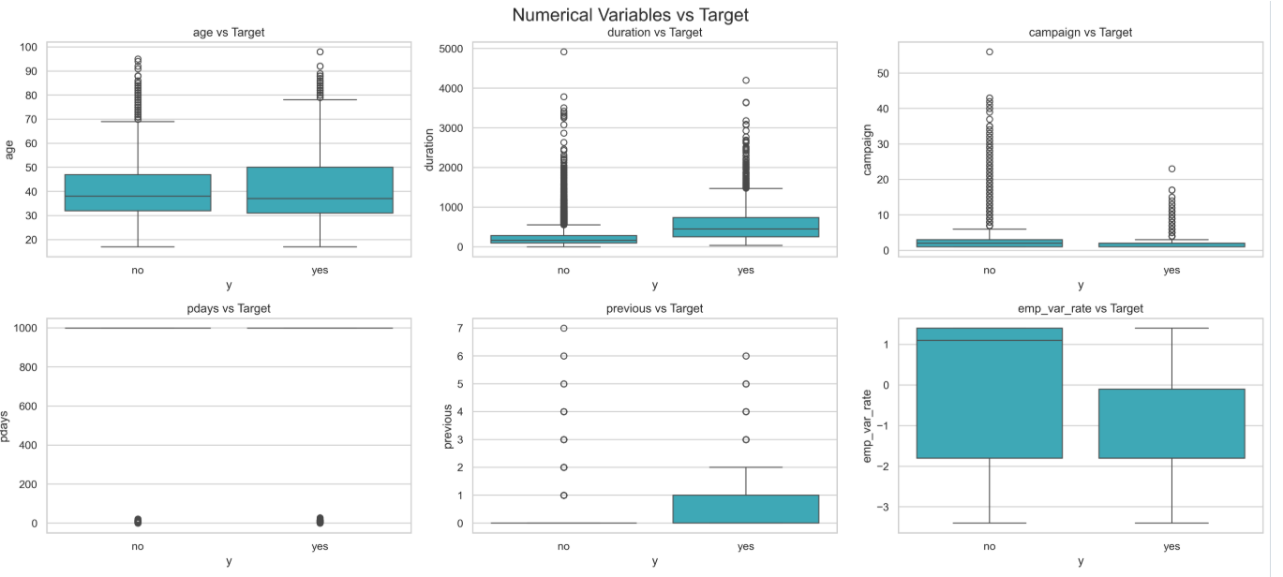
Succes rate by NUMERICAL VARIABLES #1 (AGE, DURATION, CAMPAIGN, PDAYS, PREVIOUS, EMP_VAR_RATE)
Higher tendency for older individuals to adhere to subscribe to Long-Term;
Duration of call clearly influences the likelihood of campaign success:
Shorter calls are more likely to lead to failure;

Slide 19
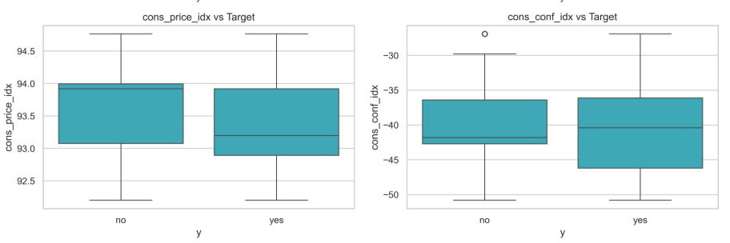
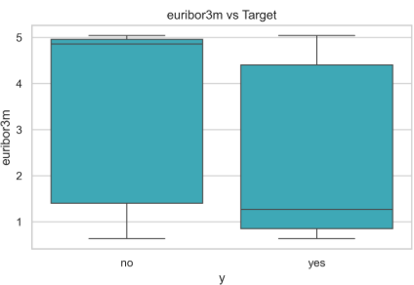
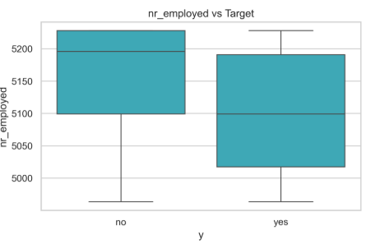
Succes rate by NUMERICAL VARIABLES #2 (CONS_PRICE_IDX, CONS_CONF_IDX,EURIBOR3M, NR_EMPLOYED)
Big variance across all macro economics variables, meaning that each factor is not discriminative by himself;
Euribor3m have higher discrimination power. Where positive outcomes tend to occur when euribor is low and negative outcomes when euribor rates are high;
Number of employed also shows to have impact on target variable;

Slide 20
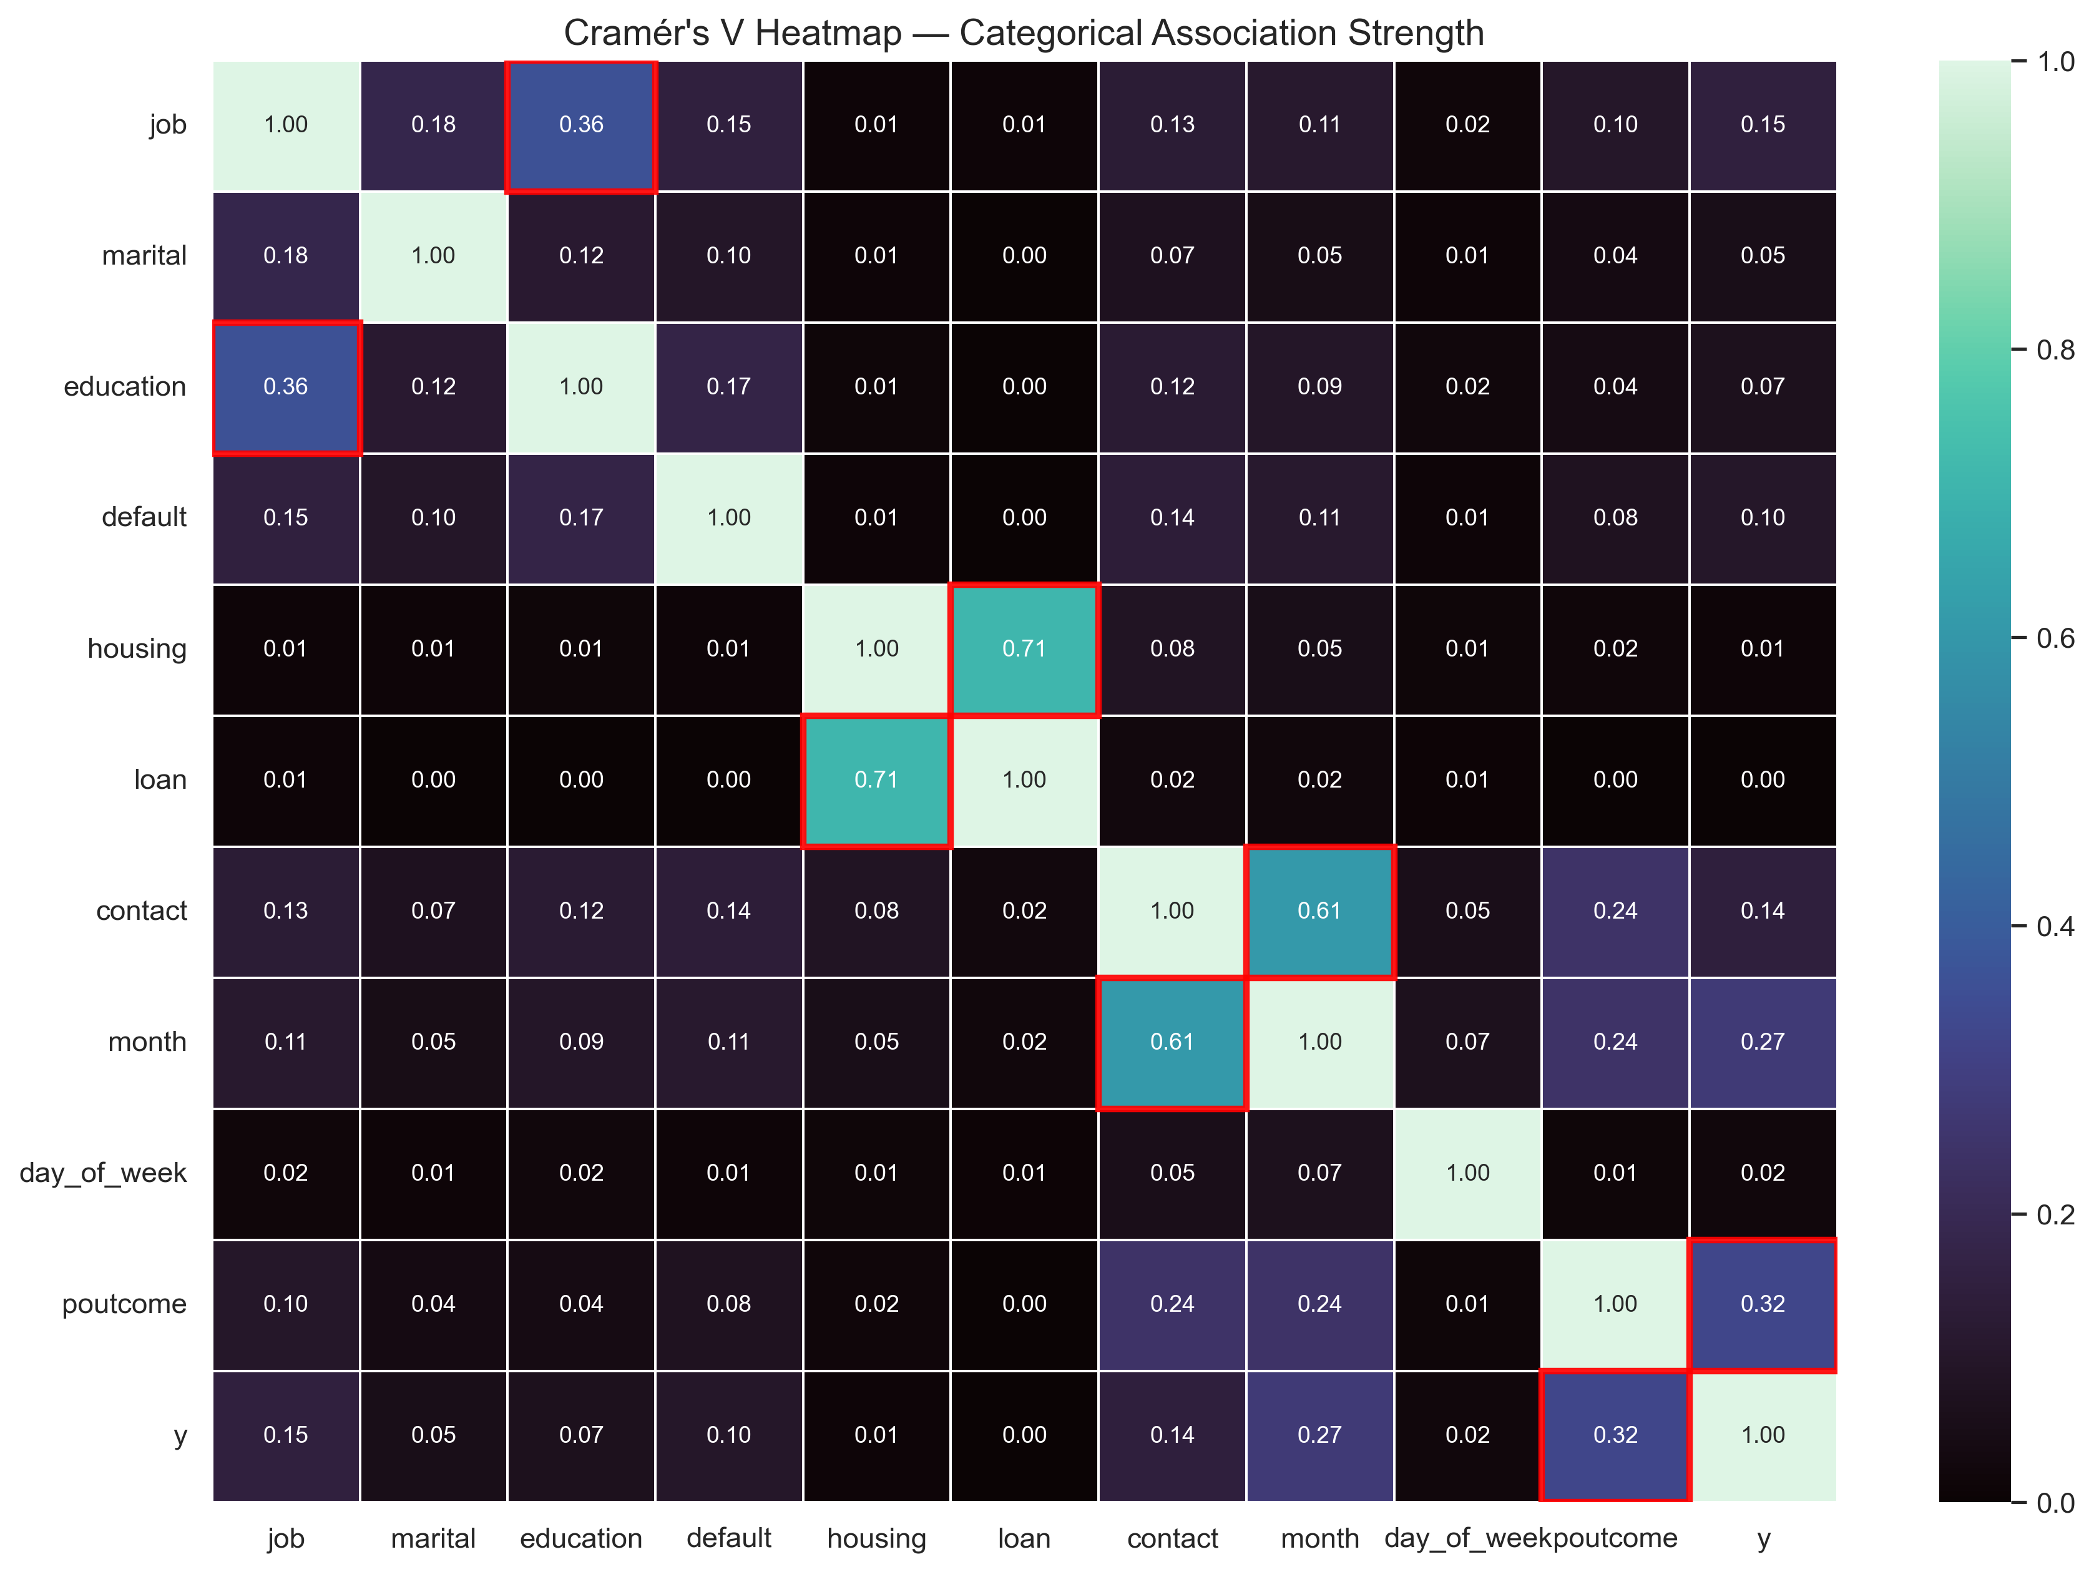
CATEGORICAL FEATURE ASSOCIATION
Housing vs Loan has a strong relationship (0.71) revealing that most people that contract a housing loan also adhere more to contract personal loans;
Contac vs Month show a high level of relationship, revealing an operational choice on when and how to call customer;
Poutcome and target variable have a relevant relationship demonstrating that customers with previous successful campaigns tend to adhere more to new ones;
Education and Job, has expected, demonstrate a relevant strength between themselves;

Slide 21
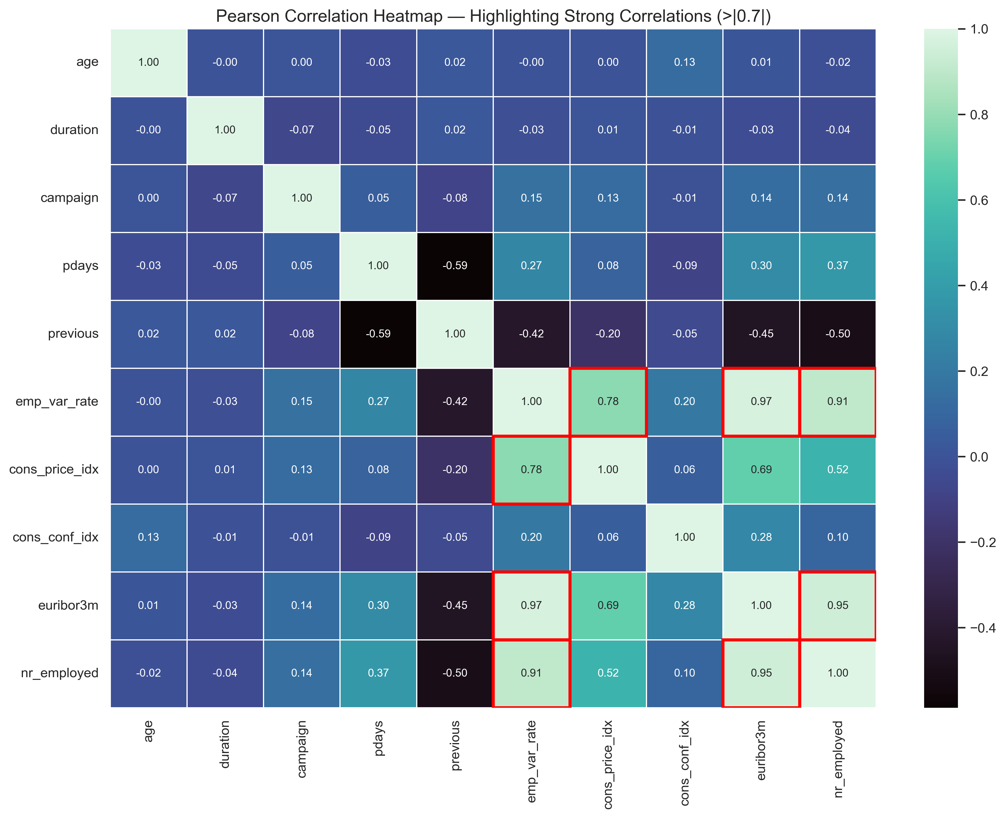
numerical FEATURE ASSOCIATION
Most Variables are independent and mutually exclusive;
Strong correlation between Macro Economic Factors:
Use of Principal Component Analysis to reduce dimensionality could be beneficial

Slide 22
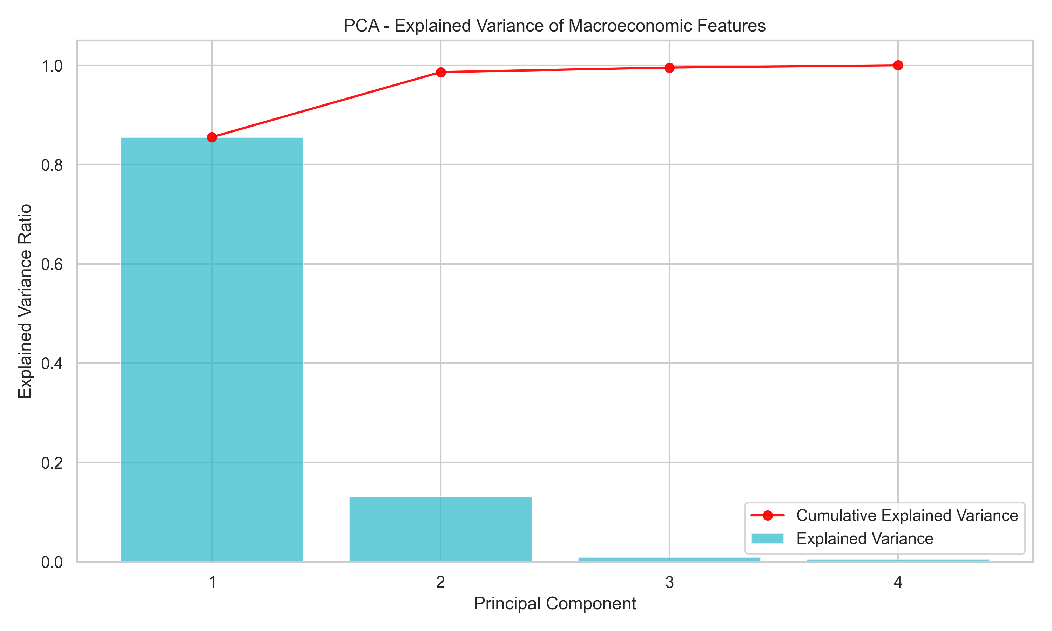
Principal component Analysis (Macroeconomic indicators)
Macro-economic variables are highly correlated with themselves ;
The firs 2 PCA features can explain over 90% of Explained Variance of Macroeconomic Features;
Decision:
Use the first 2 PCA variables instead of Euribor_3m, Emp_var_rate, cons_price_idx, nr_employed

Slide 23
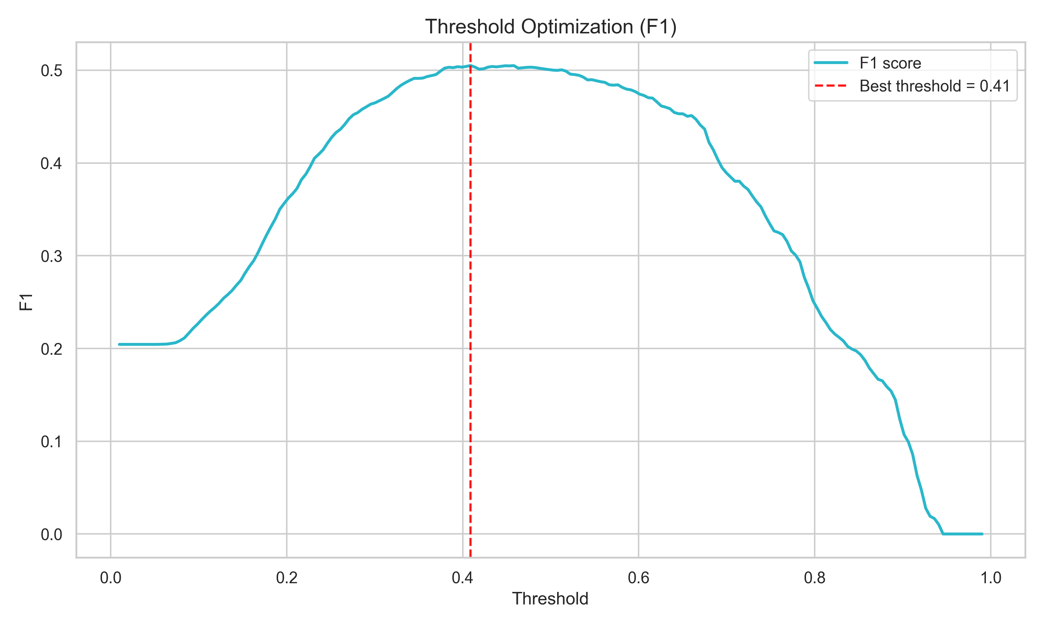
XGBOOST: threshold optimization to enhance f1 score
For Bank Telemarketing campaign the capability of predicting Positive Outcomes is of extreme importance ( identifying when and whom to call)
Use of optimize threshold is suitable to increase F1 score in detriment to accuracy;
Model will predict a successful case if probability is above 0.4

Slide 24
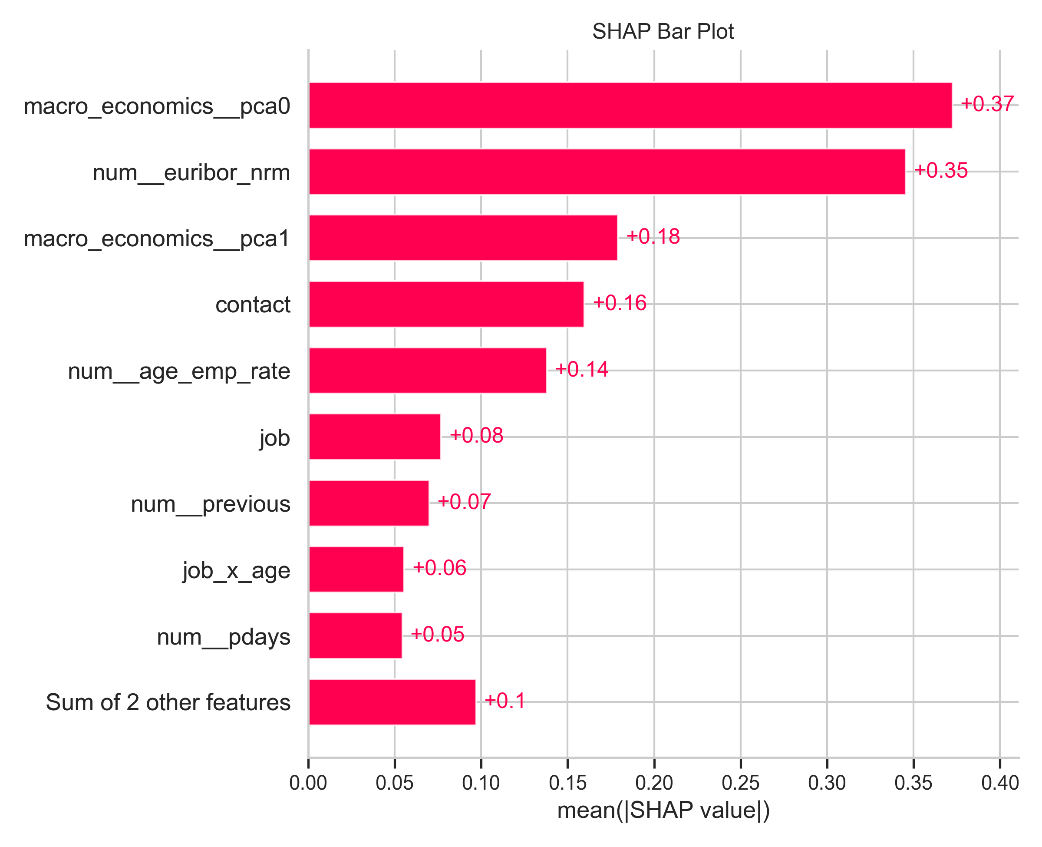
XGBOOST: SHAP ANALYSIS - WHICH FEATURES INFLUENCE THE MOST...
Macro economic variables contribute (top 3 features) contribute highly for the outcome ;
Contact and Age_emp_Rate also have a signficant impact on the prediction;
Features like Job_Age, pdays, poutcome and month_cos are the least impactful

